Slide 1
Team: I need a job Topic: movie analysis 2019 Pre-covid joy Team Members: Dakota Newcomb David Niles Noah Jaramillo Abby Boulter
Can rating services be a good proxy for box office earnings?

Slide 2

Hypothesis & Data
Do you look at reviews before going to see a movie?
Have you ever wondered if any of the rating services affect box office sales?:
Hypothesis: Movie ratings are a good proxy for box office success.
Null Hypothesis: There is no relationship between movie ratings and box office success.
Data:
The Movie Database
Movie titles
OMDB API
Metacritics
Rotten Tomatoes
IMDB
Box office earnings

Slide 3
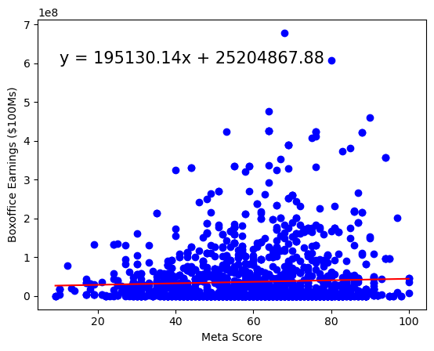
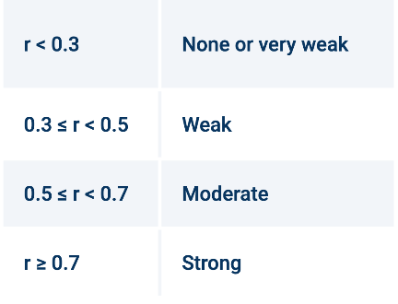
Meta score
WHAT IS METASCORE?: Metacritic is a scoring system launched in 1999 that accumulates reviews of films, TV shows, music albums and video games. They use a minimum of 4 reviews from some of the world’s most respected critics to apply a weighted average that provides the ‘Metascore’ for the movie.
Linear regression: No statistically significant relationship.
Pvalue: 0.05

Slide 4
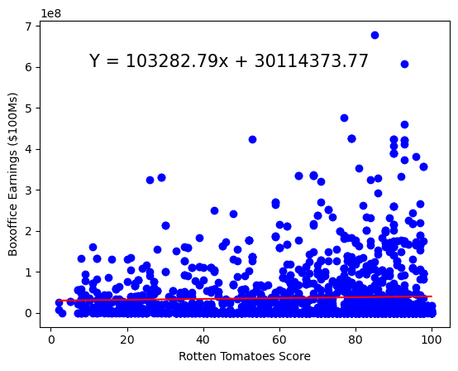
Rotten Tomatoes Score
WHAT IS Rotten Tomatoes?: Rotten tomatoes was founded in 1998 as a rating system that uses critic reviews as well as an audience score. To be in their certified fresh status they require at least 5 reviews from top critics and a minimum of 80 reviews in their audience scores for wide release films.
Linear regression: No statistically significant relationship.
Pvalue: 0.04

Slide 5
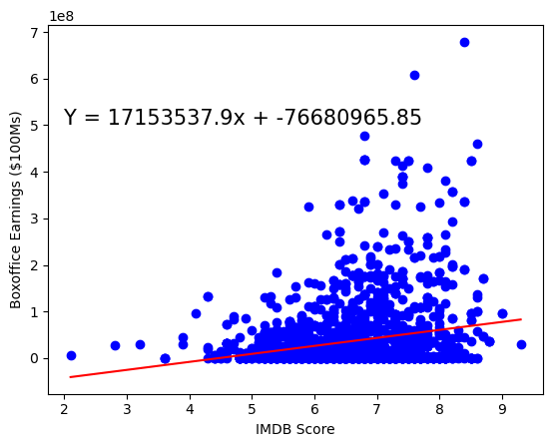
IMDB Score
WHAT IS IMDB?: IMDb was created in 1990 and uses a voter system for their ratings. Each registered user can cast one vote from 1 to 10 per title. Those votes are then aggregated into a single IMDb rating that appears on the title page of a movie on their website.
Linear regression: Very weak relationship.
Pvalue: 0.22

Slide 6
In conclusion: based on the linear regression of each analysis we determined there was no strong relationship between the rating services and the box office earnings. However, if we were to use any, we would use iMDB as a proxy to determine box office sales.
Notes:
Consider talking about:
Stand-alone films
Superman/Batman
Justice League (JLA)
Year One
The Dark Knight Returns
DC Animated Movie Universe
DC animated universe
Justice League: Gods and Monsters
Other universes

Slide 7
Works cited
APIs:
https://www.themoviedb.org/
https://www.omdbapi.com/
Code assistance:
https://stackoverflow.com/
https://courses.bootcampspot.com/courses/3707
https://pandas.pydata.org/
Background Info:
https://www.metacritic.com/about-metascores
https://help.imdb.com/article/imdb/track-movies-tv/ratings
https://www.rottentomatoes.com/about

